Slide 1
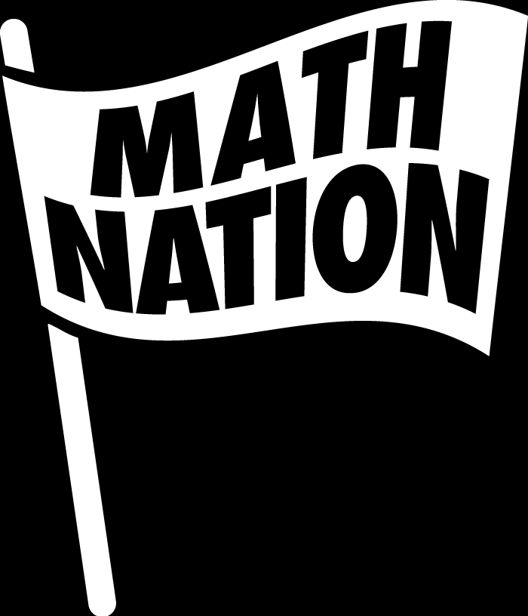
Geometry
Unit 10, Lesson 8 Solving Problems Involving Intersection of Secants Volume 2, pg. 159

Slide 2


Benchmark
MA.912.GR.6.2
Solve mathematical and real-world problems involving the measures of arcs and related angles.
volume 2, pg. 159

Slide 3
Integrated Mathematical Thinking and Reasoning Standards
MA.K12.MTR.1.1 Actively participate in effortful learning both individually and collectively.
MA.K12.MTR.2.1 Demonstrate understanding by representing problems in multiple ways.
MA.K12.MTR.4.1 Engage in discussions that reflect on the mathematical thinking of self and others.
MA.K12.MTR.5.1 Use patterns and structure to help understand and connect mathematical concepts.
MA.K12.MTR.6.1 Assess the reasonableness of solutions.
MA.K12.MTR.7.1 Apply mathematics to real-world contexts.
volume 2, pg. 159

Slide 4

Learning Target
I can solve problems involving secants drawn from a point external to the circle and their related angles.
volume 2, pg. 159

Slide 5

Warm-Up
volume 2, pg. 160

Slide 6
10.8.1 Warm-Up: Satellite Operations Engineer
Veronica Navarro is a satellite operations engineer. Before beginning her career, she received a bachelor’s degree. One piece of advice she would give to high school students is to take as many classes in high school as possible because they are free. In her opinion, a degree beyond high school is needed in many careers because employers want to know a person can be trained and is capable of learning. Veronica’s employer paid for her to receive additional degrees as a means to further develop her abilities and deepen her learning.
Why do you think it is important for companies to know you are capable of being trained?
volume 2, pg. 160

Slide 7

Exploration
volume 2, pg. 160

Slide 8

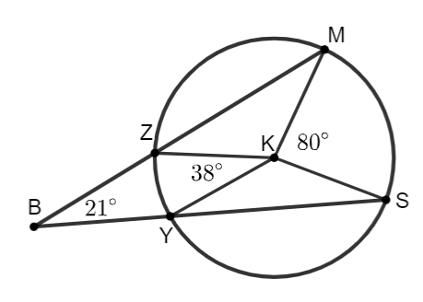
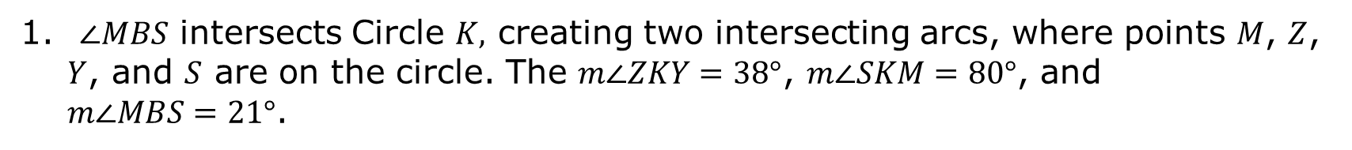
10.8.2 Exploration: Angles Formed by Secants
A secant is a line or line segment that passes through two points on a circle. In the interior of the circle, a secant line segment forms a chord.
$∠MBS$ intersects Circle $K,$ creating two intersecting arcs, where points $M$, $Z$, $Y$, and $S$ are on the circle. The $m∠ZKY=38°$, $m∠SKM=80°$, and $m∠MBS=21°$.
volume 2, pg. 160

Slide 9
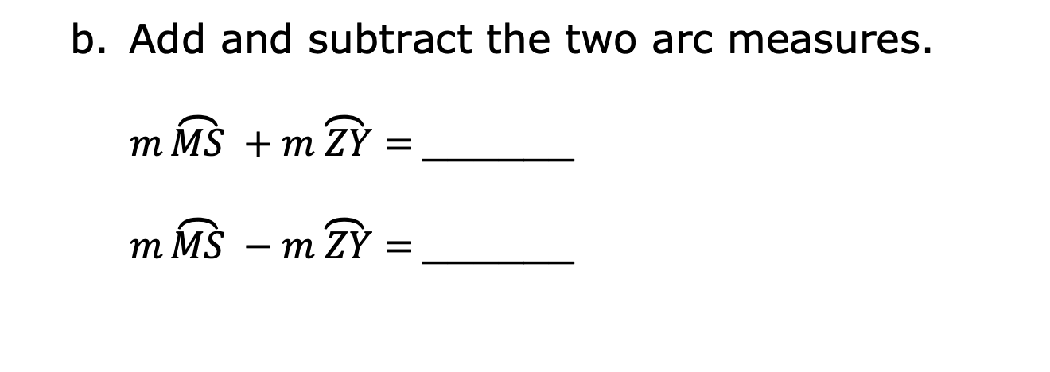
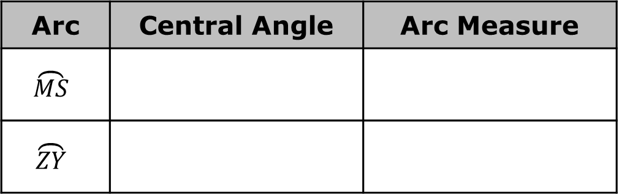
Complete the table.
Arc | Central Angle | Arc Measure
$$\overset{⏜}{MS}$$
$$\overset{⏜}{ZY}$$
Add and subtract the two arc measures.
$m\overset{⏜}{MS} +m\overset{⏜}{ ZY}=$______
$m\overset{⏜}{MS} −m\overset{⏜}{ ZY}=$______
volume 2, pg. 160

Slide 10

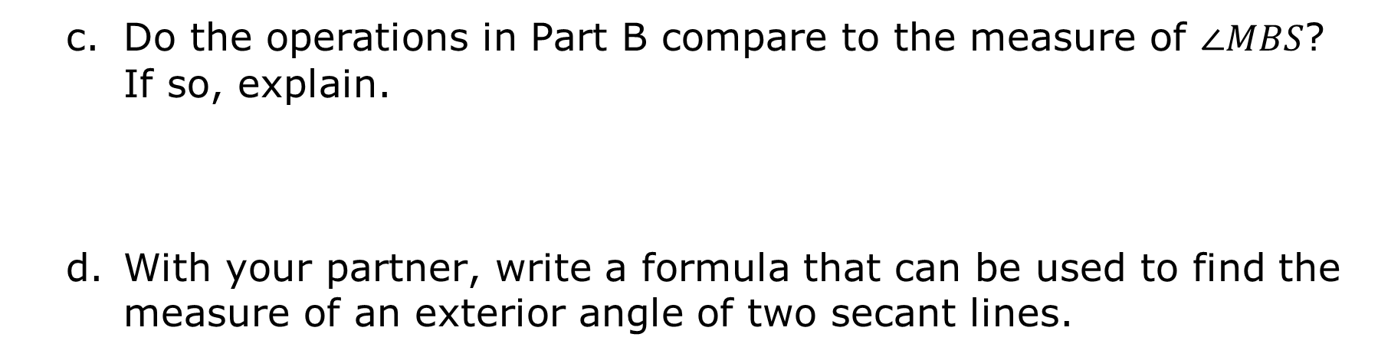
Do the operations in Part B compare to the measure of $∠MBS$? If so, explain.
With your partner, write a formula that can be used to find the measure of an exterior angle of two secant lines.
Exterior Secant Angle Theorem
The measure of an angle formed by two secant lines intersecting in the exterior of a circle is one-half the difference of the measures of the intercepted arcs.
volume 2, pg. 161

Slide 11

Guided Practice
volume 2, pg. 161

Slide 12

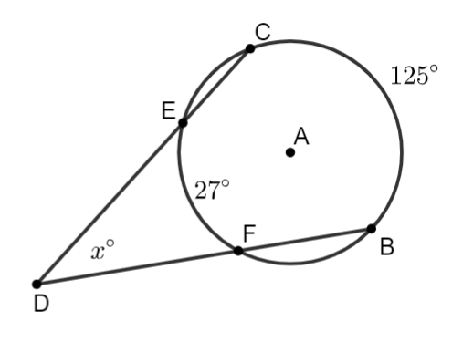
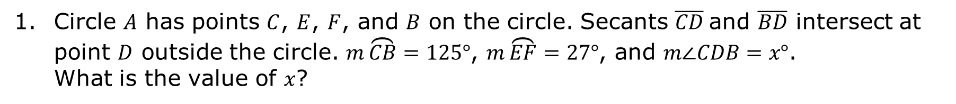
10.8.3 Guided Practice: Solving Problems Involving Angles Formed by Secants
Circle $A$ has points $C$, $E$, $F$, and $B$ on the circle. Secants $\overline{CD}$and $\overline{BD}$ intersect at point $D$ outside the circle. $m\overset{⏜}{CB}=125°$, $m\overset{⏜}{EF}=27°$, and $m∠CDB=x°$. What is the value of $x$?
volume 2, pg. 161

Slide 13
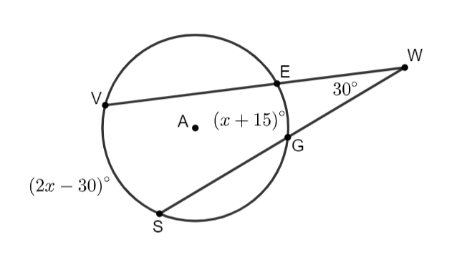


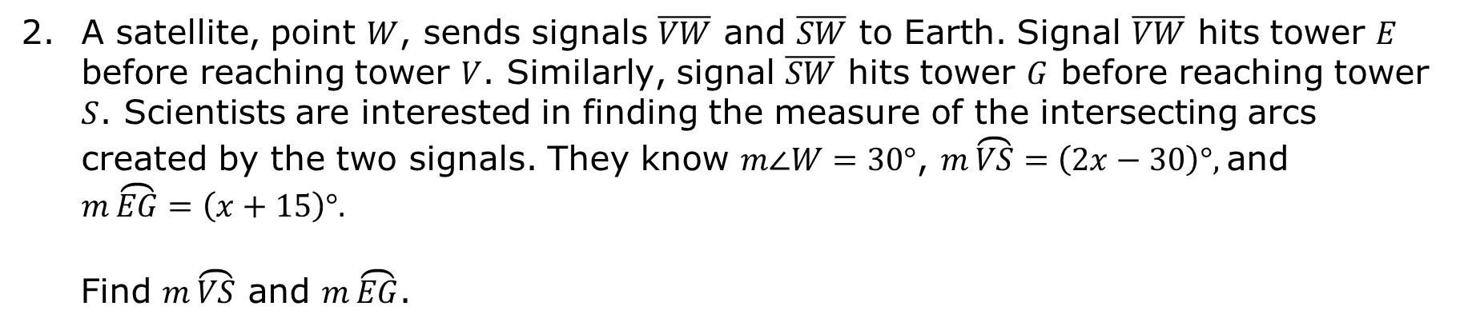
A satellite, point $W$, sends signals $\overline{VW}$ and $\overline{SW}$ to Earth. Signal $\overline{VW}$ hits tower $E$ before reaching tower $V$. Similarly, signal $\overline{SW}$ hits tower $G$ before reaching tower $S$. Scientists are interested in finding the measure of the intersecting arcs created by the two signals. They know $m∠W=30°$, $m\overset{⏜}{VS}=\left(2x−30\right)°,$and $m\overset{⏜}{EG}=\left(x+15\right)°.$
Find $m\overset{⏜}{VS}$ and $m\overset{⏜}{EG}$.
volume 2, pg. 162

Slide 14

Your Turn
volume 2, pg. 162

Slide 15
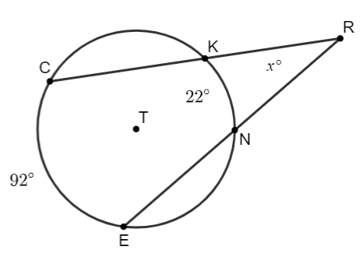
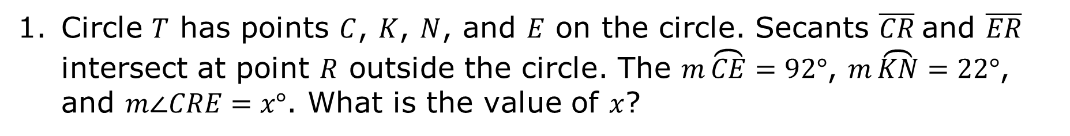
10.8.4 Your Turn!
Circle $T$ has points $C$, $K$, $N$, and $E$ on the circle. Secants $\overline{CR}$and $\overline{ER}$ intersect at point $R$ outside the circle. The $m\overset{⏜}{CE}=92°$, $m\overset{⏜}{KN}=22°$, and $m∠CRE=x°$. What is the value of $x$?
volume 2, pg. 162

Slide 16
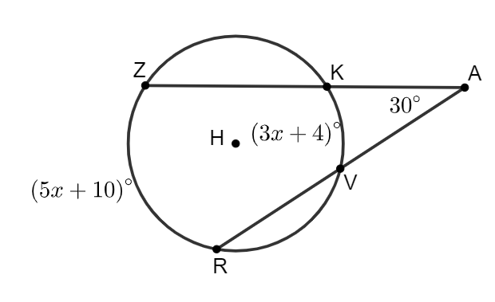
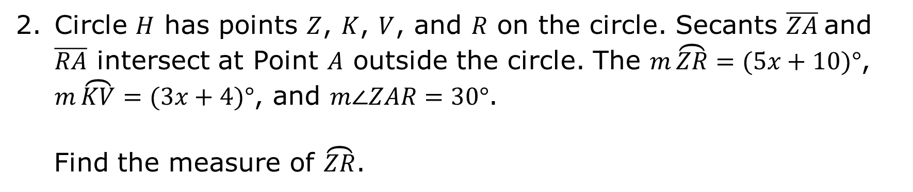
Circle $H$ has points $Z$, $K$, $V$, and $R$ on the circle. Secants $\overline{ZA}$and $\overline{RA}$ intersect at Point $A$ outside the circle. The $m\overset{⏜}{ZR}=(5x+10)°$, $m\overset{⏜}{KV}=(3x+4)°$, and $m∠ZAR=30°$.
Find the measure of $\overset{⏜}{ZR}$.
volume 2, pg. 163

Slide 17

Wrap-Up
volume 2, pg. 163

Slide 18
10.8.5 Wrap-Up: Cool Down
Write a short note to a friend who missed class summarizing today’s lesson.
volume 2, pg. 163

